Slide 1

Course Code: CSE 299 Section: 04 Project Group: 05 Group Members: Rishat Bin Sultan (2312559042) MD Tamim Hasan (2232239642) Fariha Islam (2311101642)
Group 05 | Rishat Bin Sultan, MD Tamim Hasan, Fariha Islam

Slide 2
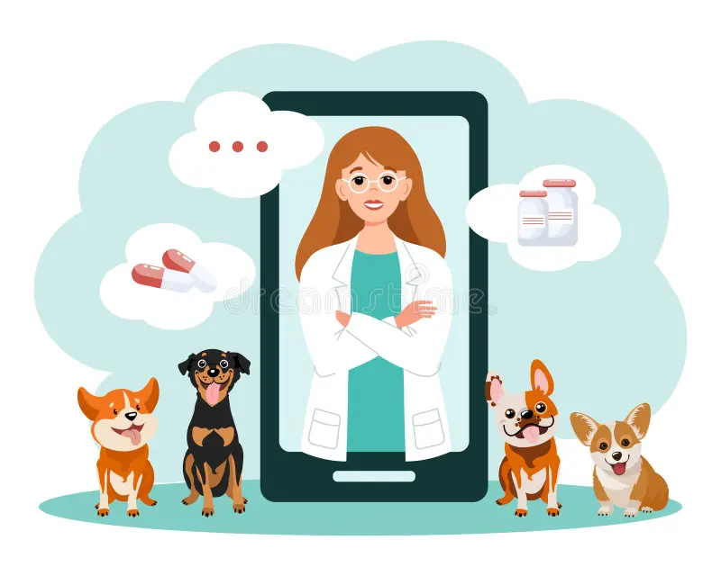
Smart Veterinary Care System with AI-Based Disease Detection
Group 05 | Rishat Bin Sultan, MD Tamim Hasan, Fariha Islam

Slide 3

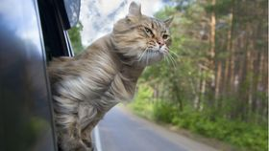

Problem Statement
Limited access to veterinary services (distance, time constraints)
Delay in identifying common pet diseases
Difficulty obtaining veterinary products quickly
Existing platforms lack intelligent health-support features
Group 05 | Rishat Bin Sultan, MD Tamim Hasan, Fariha Islam

Slide 4

Proposed Solution
Online veterinary e-commerce system
AI-based disease detection (image/symptom based)
Centralized system for users, admin, and delivery
Goal: Improve accessibility, awareness, and convenience
Group 05 | Rishat Bin Sultan, MD Tamim Hasan, Fariha Islam

Slide 5
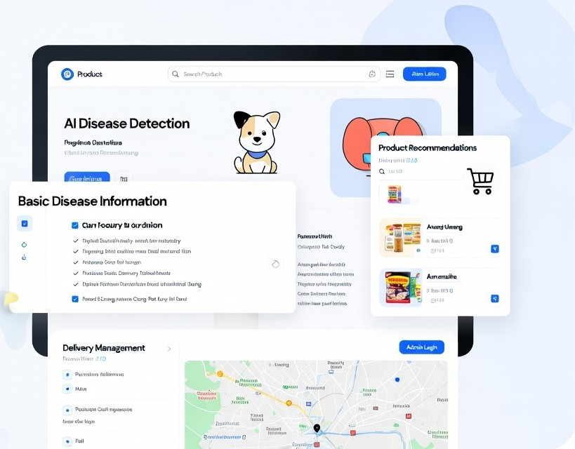
Project objectives
Develop a user-friendly online veterinary shop
Provide AI-based preliminary disease detection
Offer basic disease information and precautions
Integrate product recommendations with disease results
Ensure efficient admin and delivery management
Faster communication between vets and owners
Group 05 | Rishat Bin Sultan, MD Tamim Hasan, Fariha Islam

Slide 6

Target users
Veterinarians
Animal Owners
Clinic Administrators
Volunteers who rescuing animals
Group 05 | Rishat Bin Sultan, MD Tamim Hasan, Fariha Islam

Slide 7
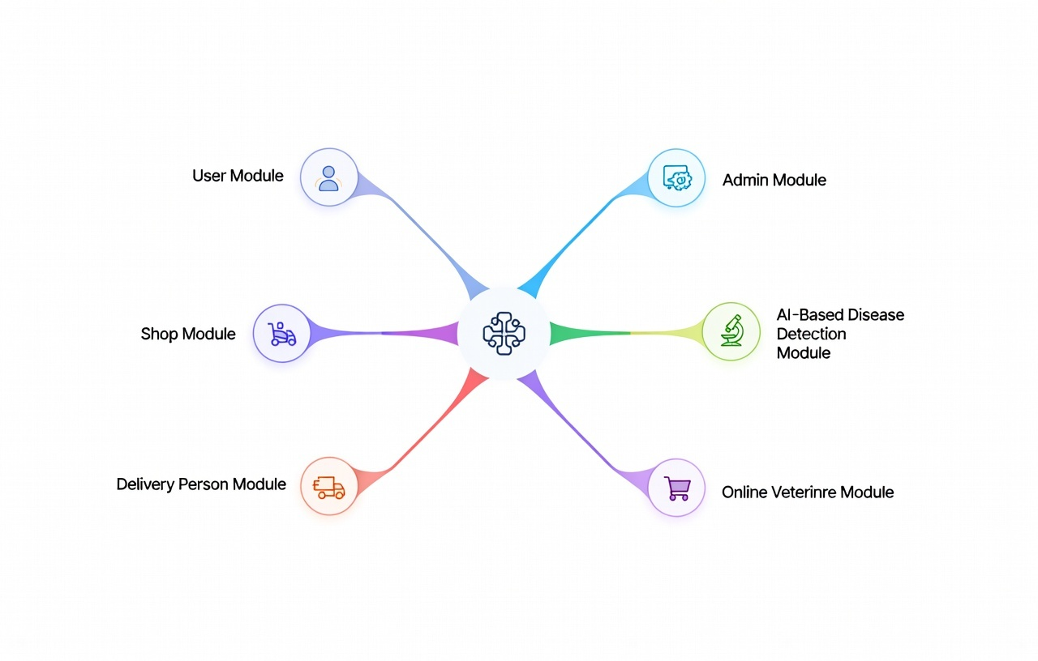
System Key Features
User Panel
Online Veterinary Shop Interface
AI-Based Disease Detection
Admin Dashboard
Product Delivery Portal
Health Records
Group 05 | Rishat Bin Sultan, MD Tamim Hasan, Fariha Islam

Slide 8
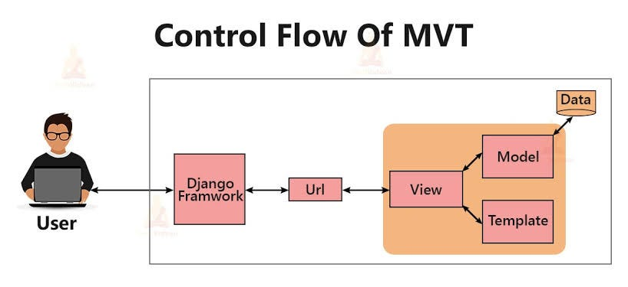
System Architecture
Three-tier architecture
Presentation Layer: Web Interface
Application Layer: Django Backend + AI Model
Data Layer: Relational Database
Group 05 | Rishat Bin Sultan, MD Tamim Hasan, Fariha Islam

Slide 9
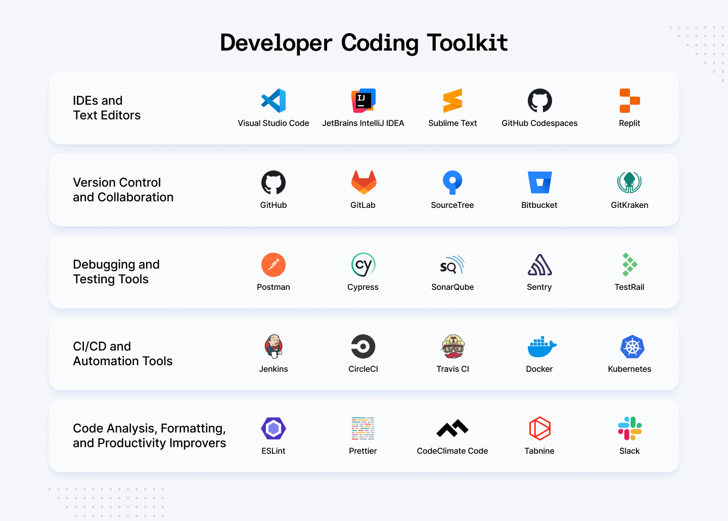
Tools & Technologies
Backend: Python, Django
Frontend: HTML, CSS, Bootstrap
Database: SQLite / MySQL
Machine Learning: scikit-learn / basic DL
Tools: VS Code, Web Browser
Group 05 | Rishat Bin Sultan, MD Tamim Hasan, Fariha Islam

Slide 10
Expected Outcomes
Functional online veterinary shop
AI-supported early disease awareness
User friendly Interface
Minimal paper work
Group 05 | Rishat Bin Sultan, MD Tamim Hasan, Fariha Islam

Slide 11

Conclusion
Combines e-commerce with AI-based health support
Enhances convenience and early awareness
Supports informed decision-making for pet owners
Group 05 | Rishat Bin Sultan, MD Tamim Hasan, Fariha Islam

